Slide 1
15. Dynamic Programming
鮑興國, Ph.D.
National Taiwan University of Science & Technology

Slide 2
Outline
Introduction to Dynamic Programming
Matrix-chain multiplication
Elements of dynamic programming
Longest common subsequence
The Generalized Distributed Law
Reference: Introduction to Algorithms (2nd ed.) T.H. Cormen, C.E.Leiserson, R.L.Rivest and C. Stein, 2002

Slide 3
Dynamic Programming
Dynamic programming is typically applied to optimization problems. In such problems there can be many possible solutions. Each solution has a value, and we wish to find a solution with the optimal (minimum or maximum) value.
E.g.: min_{x} y = f (x) = x² – 2x + 1
Dynamic programming like divide-and-conquer method, solves problems by combining the solutions to subproblems. But for DP, the subproblems are not independent.

Slide 4
Semantic Note
(By Richard Bellman) “Programming” means planning, decision making and “Dynamic” means multistage, time-varying, …
Programming so named because
Originally associated with movements through time and space (e.g., aircraft gaining altitude, thus “dynamic”)
“programming” by analogy to “linear programming” and other forms of optimization
This approach can be used in many cases that are not in fact “dynamic”

Slide 5
Development of DP algorithm
The development of a DP algorithm can be broken into a sequence of four steps:
Characterize the structure of an optimal solution.
Recursively define the value of an optimal solution.
Compute the value of an optimal solution in a bottom-up fashion.
Construct an optimal solution from computed information.

Slide 6
15.1 Coin Counting Problems

Slide 7
Counting coins
To find the minimum number of US coins to make any amount
Assume we have 1¢, 5¢, 10¢, 25¢
Assume we have unlimited number of coins.
Example 1: 31¢ = 25¢ + 5¢ + 1¢
Example 2: 31¢ = 10¢ + 10¢ + 10¢ + 1¢

Slide 8
A greedy approach…
To find the minimum number of US coins to make any amount, the greedy method always works
At each step, just choose the largest coin that does not overshoot the desired amount
The greedy method would not work if we did not have 5¢ coins
For 31 cents, the greedy method gives seven coins (25+1+1+1+1+1+1), but we can do it with four (10+10+10+1)
The greedy method also would not work if we had a 21¢ coin
For 63 cents, the greedy method gives six coins (25+25+10+1+1+1), but we can do it with three (21+21+21)
How can we find the minimum number of coins for any given coin set?

Slide 9
Coin set for examples
For the following examples, we will assume coins in the following denominations: 1¢ 5¢ 10¢ 21¢ 25¢
We’ll use 63¢ as our goal!

Slide 10
A simple solution
We always need a 1¢ coin, otherwise no solution exists for making one cent
To make K cents:
If there is a K-cent coin, then that one coin is the minimum
Otherwise, for each value i < K,
Find the minimum number of coins needed to make i cents
Find the minimum number of coins needed to make K – i cents
Choose the i that minimizes this sum
This algorithm can be viewed as divide-and-conquer, or as brute force
This solution is very recursive
It requires exponential work
It is infeasible to solve for 63¢

Slide 11
Another solution
We can reduce the problem recursively by choosing the first coin, and solving for the amount that is left
For 63¢:
One 1¢ coin plus the best solution for 62¢
One 5¢ coin plus the best solution for 58¢
One 10¢ coin plus the best solution for 53¢
One 21¢ coin plus the best solution for 42¢
One 25¢ coin plus the best solution for 38¢
Choose the best solution from among the 5 given above
Instead of solving 62 recursive problems, we solve 5
This is still a very expensive algorithm

Slide 12
A dynamic programming solution
Idea: Solve first for one cent, then two cents, then three cents, etc., up to the desired amount
Save each answer in an array !
For each new amount N, compute all the possible pairs of previous answers which sum to N
For example, to find the solution for 13¢,
First, solve for all of 1¢, 2¢, 3¢, ..., 12¢
Next, choose the best solution among:
Solution for 1¢ + solution for 12¢
Solution for 2¢ + solution for 11¢
Solution for 3¢ + solution for 10¢
Solution for 4¢ + solution for 9¢
Solution for 5¢ + solution for 8¢
Solution for 6¢ + solution for 7¢

Slide 13
Example 1
Suppose coins are 1¢, 3¢, and 4¢ to make 6¢
There’s only one way to make 1¢ (one coin)
To make 2¢, try 1¢+1¢ (one coin + one coin = 2 coins)
To make 3¢, just use the 3¢ coin (one coin)
To make 4¢, just use the 4¢ coin (one coin)
To make 5¢, try
1¢ + 4¢ (1 coin + 1 coin = 2 coins)
2¢ + 3¢ (2 coins + 1 coin = 3 coins)
The first solution is better, so best solution is 2 coins
To make 6¢, try
1¢ + 5¢ (1 coin + 2 coins = 3 coins)
2¢ + 4¢ (2 coins + 1 coin = 3 coins)
3¢ + 3¢ (1 coin + 1 coin = 2 coins) – best solution

Slide 14
Example 2
Suppose coins are 1¢, 5¢, 10¢, 21¢, 25¢ to make 63¢
There’s only one way to make 1¢ (one coin)
To make 2¢, try 1¢+1¢ (one coin + one coin = 2 coins)
To make 3¢ = 1¢+1¢+1¢ (3 coins)
…
To make 5¢, just use one 5¢ coin
…
To make 11¢, try
1¢ + 10¢ (1 coin + 1 coins = 2 coins) – best solution
2¢ + 9¢ (2 coins + 5 coin = 7 coins)
…
…
63¢ = 21¢+21¢+21¢

Slide 15
15.2 Matrix-chain multiplication

Slide 16
Matrix-chain multiplication
How to compute A₁A₂⋅⋅⋅A_{n} where A_{i} is a matrix ∀ i.
Example: A₁A₂ A₃A₄
A product of matrices is fully parenthesized if it is either a single matrix, or the product of two fully parenthesized matrix products, surrounded by parentheses.
(M₁ · M₂) is FP if M₁ and M₂ are FP

Slide 17
MATRIX MULTIPLY
MATRIX-MULTIPLY(A, B)
1 if columns[A] ≠ rows[B]
2 then error “incompatible dimensions”
3 else for i ← 1 to rows[A]
4 do for j ← 1 to columns[B]
5 do C[i, j] ← 0
6 for k ← 1 to columns[A]
7 do C[i, j] ← C[i, j] + A[i, k] ⋅ B[k, j]
8 return C

Slide 18
Complexity:
Let A be a p × q matrix, and B be a q × r matrix, then the complexity (or the number of scalar multiplications) is p × q × r to compute the product A ⋅ B.

Slide 19
Example:
A₁ is a 10×100 matrix, A₂ is a 100×5 matrix, and A₃ is a 5×50 matrix. Then
((A₁ A₂) A₃) takes
10 ⋅ 100 ⋅ 5 + 10 ⋅ 5 ⋅ 50 = 7500 time.
However
(A₁(A₂ A₃)) takes
100 ⋅ 5 ⋅ 50 + 10 ⋅ 100 ⋅ 50 = 75000 time.

Slide 20
The matrix-chain multiplication problem:
Given a chain ⟨A₁, A₂,…, A_{n}⟩ of n matrices, where for i = 1,…, n, matrix A_{i} has dimension p_{i−1} × p_{i}, fully parenthesize the product A₁A₂⋅⋅⋅A_{n} in a way that minimizes the number of scalar multiplications.

Slide 21
Counting the number of parenthesizations:
[Catalan numbers]

Slide 22
The development of a DP algorithm
Step 1: Characterize the structure of an optimal parenthesization
Step 2: Recursively define the value of an optimal parenthesization
Step 3: Compute the value of an optimal parenthesization in a bottom-up fashion
Step 4: Constructe an optimal solution from the computed information

Slide 23
Step1: The structure of an optimal parenthesization
Finding the optimal substructure and using it to construct an optimal solution to the problem based on optimal solutions to subproblems.
The key: finding k and we can build the global optimal solution
Optimal
((A₁A₂⋅⋅⋅A_{k})(A_{k+1}A_{k+2}⋅⋅⋅A_{n}))
Combine

Slide 24
Step 2: A recursive solution
Define m[i, j] = the minimum number of scalar multiplications needed to compute the matrix A_{i..j} = A_{i} A_{i+1}⋅⋅⋅A_{j}
Goal: to compute m[1, n]

Slide 25
The development of a DP algorithm
Step 1: Characterize the structure of an optimal parenthesization
Step 2: Recursively define the value of an optimal parenthesization
Step 3: Compute the value of an optimal parenthesization in a bottom-up fashion
Step 4: Constructe an optimal solution from the computed information

Slide 26
MATRIX-CHAIN-ORDER
MATRIX-CHAIN-ORDER(p)
1 n ← length[p] −1
2 for i ← 1 to n
3 do m[i, i] ← 0
4 for l ← 2 to n /* l is the chain length */
5 do for i ← 1 to n − l + 1
6 do j ← i + l − 1
7 m[i, j] ← ∞
8 for k ← i to j − 1
9 do q ← m[i, k] + m[k + 1, j] + p_{i−1}p_{k}p_{j}
10 if q < m[i, j]
11 then m[i, j] ← q
12 s[i, j] ← k
13 return m and s
Complexity: O(n³)
Space: Θ(n²)

Slide 27
Example:

Slide 28
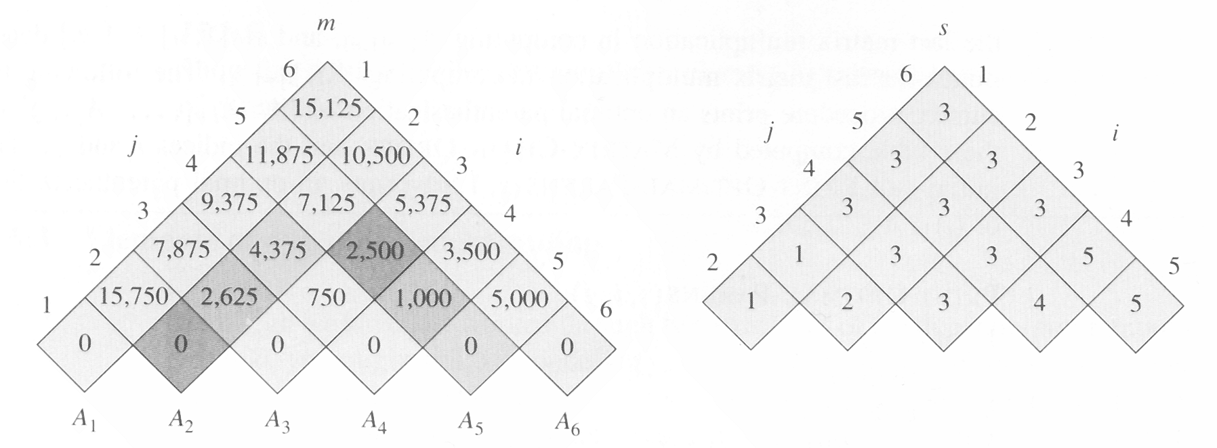
the m and s table computed by
MATRIX-CHAIN-ORDER for n = 6

Slide 29
Computing m[2, 5]
m[2,5]=
min{
m[2,2]+m[3,5]+p₁p₂p₅ = 0 + 2500 + 35·15·20 = 13000,
m[2,3]+m[4,5]+p₁p₃p₅ = 2625 + 1000 + 35·5·20 = 7125,
m[2,4]+m[5,5]+p₁p₄p₅ = 4375 + 0 + 35·10·20 = 11374
}
=7125

Slide 30
The development of a DP algorithm
Step 1: Characterize the structure of an optimal parenthesization
Step 2: Recursively define the value of an optimal parenthesization
Step 3: Compute the value of an optimal parenthesization in a bottom-up fashion
Step 4: Constructe an optimal solution from the computed information

Slide 31
PRINT-OPTIMAL-PARENS
PRINT-OPTIMAL-PARENS(s, i, j)
1 if i = j
2 then print “A”_{i}
3 else print “(“
4 PRINT-OPTIMAL-PARENS(s, i, s[i, j])
5 PRINT-OPTIMAL-PARENS(s, s[i, j] + 1, j)
6 PRINT “)”
Example: PRINT-OPTIMAL-PARENS(s, 1, 6)
((A₁(A₂A₃))((A₄A₅)A₆))

Slide 32
15.3 Elements of dynamic programming

Slide 33
Optimal substructure:
We say that a problem exhibits optimal substructure if an optimal solution to the problem contains within its optimal solutions to subproblems.
Example: Matrix-multiplication problem

Slide 34
Follow a common pattern in discovering optimal substructure
1. You show that a solution to the problem consists of making a choice. Making this choice leaves one or more subproblems to be solved.
2. You suppose that for a given problem, you are given the choice that leads to an optimal solution.
3. Given this choice, you determine which subproblems ensue and how to best characterize the resulting space of subproblems.
4. You show that the solutions to the subproblems used within the optimal solution to the problem must themselves be optimal by using a “cut-and-paste” technique.

Slide 35
Different optimal substructures
Optimal substructure varies across problem domains in two ways:
1. how many subproblems are used in an optimal solution to the original problem, and
2. how many choices we have in determining which subproblem(s) to use in an optimal solution.
E.g.: deciding the cut point k for
matrix multiplication!

Slide 36
Subtleties
One should be careful not to assume that optimal substructure applies when it does not. Consider the following two problems in which we are given a directed graph G = (V, E) and vertices u, v ∈ V.
Unweighted shortest path:
Find a path from u to v consisting of the fewest edges. Good for Dynamic programming.
Unweighted longest simple path:
Find a simple path from u to v consisting of the most edges. Not good for Dynamic programming.
(A path is simple if all vertices in the path are distinct.)

Slide 37
DP is good to find USP
Given a shortest path from u to v, for any intermediate vertex w, we can decompose the path u  v to u  w and w  v where both u  w and w  v are both (optimal) shortest paths
w
u
v

Slide 38
DP is not good to find ULSP
The path q → r → t is a longest simple path from q to t, but the subpath q → r is not a longest simple path from q to r (should be q → s → t → r), nor is the subpath r → t a longest simple path from r to t (should be r → q → s → t).
q
r
s
t
However, when we combine the longest simple path q → s → t → r and r → q → s → t, we get q → s → t → r → q → s → t which is not simple.

Slide 39
Overlapping subproblems:
Example: MAXTRIX-CHAIN-ORDER

Slide 40
RECURSIVE-MATRIX-CHAIN
RECURSIVE-MATRIX-CHAIN(p, i, j)
/* inefficient */
1 if i = j
2 then return 0
3 m[i, j] ← ∞
4 for k ← i to j – 1
5 do q ← RMC(p, i, k) + RMC(p, k+1, j) + p_{i–1}p_{k} p_{j}
6 if q < m[i, j]
7 then m[i, j] ← q
8 return m[i, j]

Slide 41
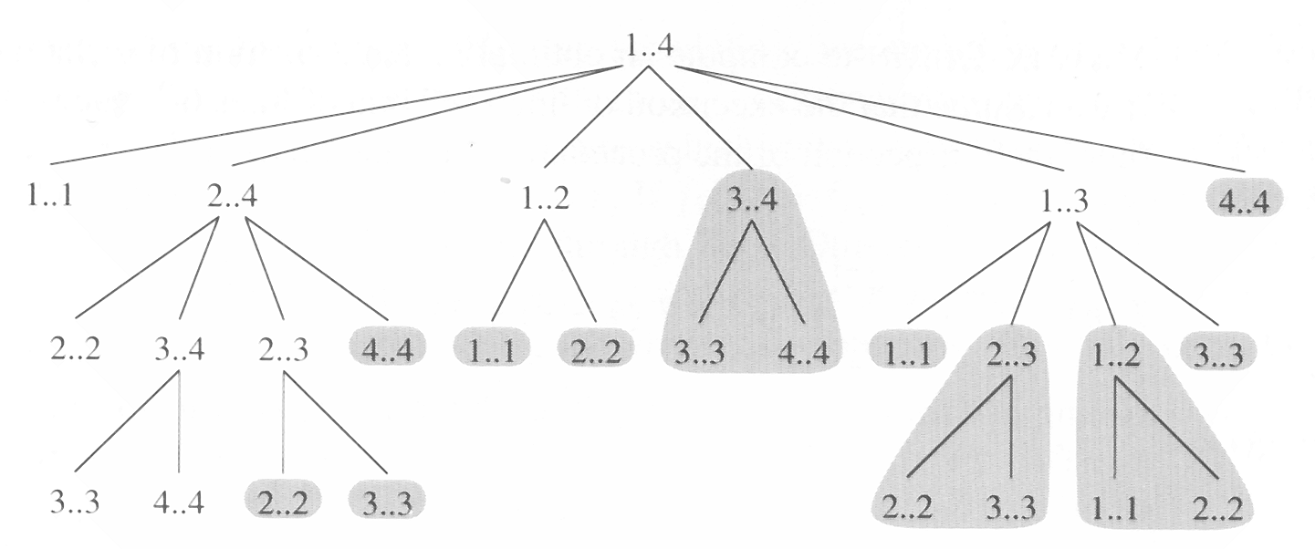
The recursion tree for the computation
of RECURSUVE-MATRIX-CHAIN(p, 1, 4)
The computations in a shaded subtree can be replaced by a single table lookup in MEMOIZED-MATRIX-CHAIN(p, 1, 4)

Slide 42
Complexity of RMC
We can prove that T(n) = Ω(2^{n}) using the substitution method.

Slide 43
Complexity of RMC (cont.)
Solution:
bottom up (DP)
memoization (memoize the natural, but inefficient, recursive program)

Slide 44
MEMOIZED-MATRIX-CHAIN
MEMOIZED-MATRIX-CHAIN(p)
1 n ← length[p] –1
2 for i ← 1 to n
3 do for j ← i to n
4 do m[i, j] ← ∞
5 return LOOKUP-CHAIN(p, 1, n)

Slide 45
LOOKUP-CHAIN
Time Complexity: O(n³)
Space: Θ(n²)
LOOKUP-CHAIN(p, i, j)
1 if m[i, j] < ∞
2 then return m[i, j]
3 if i = j
4 then m[i, j] ← 0
5 else for k ← i to j – 1
6 do q ← LC(p, i, k) + LC(p, k+1, j)+p_{i–1}p_{k} p_{j}
7 if q < m[i, j]
8 then m[i, j] ← q
9 return m[i, j]

Slide 46
15.4 Longest Common Subsequence

Slide 47
Longest Common Subsequence
X = ⟨ A, B, C, B, D, A, B ⟩
Y = ⟨ B, D, C, A, B, A ⟩
⟨ B, C, A ⟩ is a common subsequence of both X and Y.
⟨ B, C, B, A ⟩ or ⟨ B, C, A, B ⟩ is the longest common subsequence of X and Y.

Slide 48
Longest-common-subsequence problem:
We are given two sequences X = ⟨ x₁, x₂, ..., x_{m} ⟩ and Y = ⟨ y₁, y₂, ..., y_{n} ⟩ and wish to find a maximum length common subsequence of X and Y.
Notation: X_{i} = ⟨ x₁,x₂,...,x_{i} ⟩.

Slide 49
Theorem 16.1. (Optimal substructure of LCS)
Let X = ⟨x₁, x₂, ..., x_{m}⟩ and Y = ⟨y₁, y₂, ..., y_{n}⟩ be two input sequences, and let Z = ⟨z₁, z₂, ..., z_{k}⟩ be any LCS of X and Y.
1. If x_{m} = y_{n}
then z_{k} = x_{m} = y_{n} and Z_{k–1} is an LCS of X_{m–1} and Y_{n–1}.
2. If x_{m} ≠ y_{n}
then z_{k} ≠ x_{m} implies Z is an LCS of X_{m–1} and Y.
3. If x_{m} ≠ y_{n}
then z_{k} ≠ y_{n} implies Z is an LCS of X and Y_{n–1}.

Slide 50
A recursive solution to subproblem
Define c[i, j] to be the length of an LCS of X_{i} and Y_{j} , then
c[i, j] =

Slide 51
Computing the length of an LCS
LCS-LENGTH(X, Y)
1 m ← length[X]
2 n ← length[Y]
3 for i ← 1 to m
4 do c[i, 0] ← 0
5 for j ← 1 to n
6 do c[0, j] ← 0
7 for i ← 1 to m
8 do for j ← 1 to n
c[i, j]: the length of LCS
b[i, j]: the path to reconstruct LCS

Slide 52
Computing the length of an LCS (cont.)
9 do if x_{i} = y_{j}
10 then c[i, j] ← c[i – 1, j – 1]+1
11 b[i, j] ← “”
12 else if c[i – 1, j] ≥ c[i, j – 1]
13 then c[i, j] ← c[i – 1, j]
14 b[i, j] ← “⬆”
15 else c[i, j] ← c[i, j – 1]
16 b[i, j] ← “⬅”
17 return c and b

Slide 53
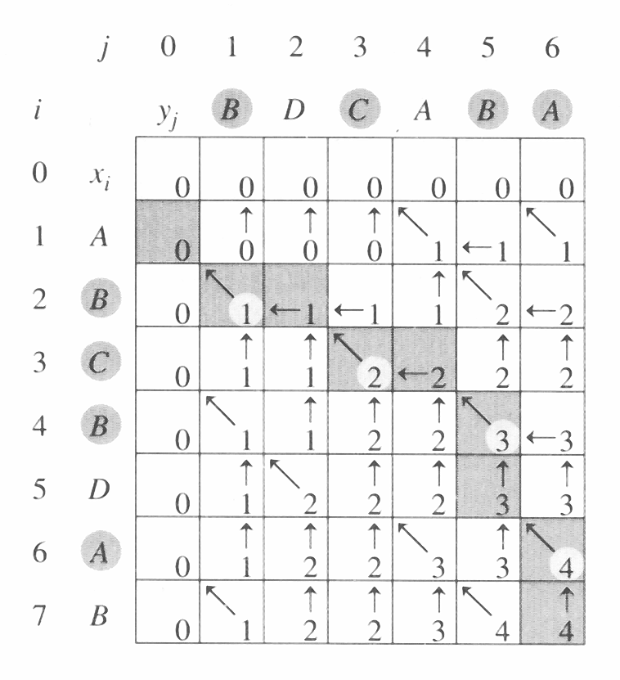
Complexity: O(mn)

Slide 54
PRINT-LCS
PRINT-LCS(b, X, i, j )
1 if i = 0 or j = 0
2 then return
3 if b[i, j] = “”
4 then PRINT-LCS(b, X, i – 1 , j – 1)
5 print x_{i}
6 elseif b[i, j] = “⬆”
7 then PRINT-LCS(b, X, i – 1, j)
8 else PRINT-LCS(b, X, i, j – 1)
Complexity: O(m+n)

Slide 55
15.5 The Generalized Distributed Law

Slide 56
The Generalized Distributed Law
a b + a c = a (b + c)
left: 2 “×” 1 “+”, right: 1 “×”, 1 “+”

Slide 57
The Shortest Path
l
A
B
d_{kl}
k
0 1 2 3 4 ⋅ ⋅ ⋅ n – 1 n
Given: a multilayer network, with distance d_{kl} shown on edges between nodes in neighboring layers.
Problem: find the shortest path from A to B

Slide 58
A DP Approach
All paths have the same start state A, so v₀(0) = 0. By keeping pointers backwards, the actual path can be found by backtracking. The full algorithm:

Slide 59
The Most Probable Path
l
A
B
p_{kl}
k
0 1 2 3 4 ⋅ ⋅ ⋅ n – 1 n
Given: a multilayer network, with transition probability p_{kl} shown on edges.
Problem: find the most probable path from A to B
(One of the) solutions is given by Viterbi algorithm, using dynamic programming

Slide 60
The Viterbi Algorithm
All paths have the same start state A, so v₀(0) = 1. By keeping pointers backwards, the actual path can be found by backtracking. The full algorithm:

Slide 61
Commutative Semi-ring
A set K, together with two binary operations called “+” and “⋅”, which satisfy the following three axioms:
The operations “+” is associative and commutative, and there is an additive identity element called “0” s.t. k + 0 = k, ∀ k
The operation “⋅” is also associative and commutative, and there is a multiplicative identity element called “1” s.t. k ⋅ 1 = k, ∀ k
The distributive law holds, i.e.
(a ⋅ b) + (a ⋅ c) = a ⋅ (b + c) , ∀ a, b, c from K
A semi-ring is a commutative ring without the additive inverse

Slide 62
Example: max-product
K = R⁺ = [0, +∞), “+”: max, “⋅”: usual multiplication
Checking the operations “+”
max(k, 0) = k, ∀ k ; i.e., identity: 0
Checking the operation “⋅”
k ⋅ 1 = k, ∀ k ; i.e., identity: 1
The distributive law holds, i.e.
max{a ⋅ b, a ⋅ c} = a ⋅ max (b, c) , ∀ a, b, c from K
Other examples: min-product, min-sum, max-sum, etc.

Slide 63
Viterbi vs. GDL
Viterbi is just a form of GDL, by choosing an appropriate semi-ring
In fact, many dynamic programming processes can be interpreted by GDL
Other examples: Baum-Welch algorithm, FFT(fast Fourier transform) on any finite Abelian group, Gallager-Tanner-Wiberg decoding algorithm, BCJR algorithm, Pearl’s “belief propagation”, Shafer-Shenoy probability propagation algorithm, turbo decoding algorithm, etc.

